Slide 1
Volume Control Using Hand Gesture Recognition
Enhancing User Interaction with Hand Gestures

Slide 2

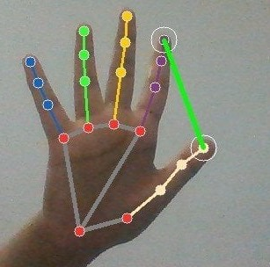
Introduction
In an era characterized by technological advancements and digital transformation, the design of user interfaces plays a pivotal role in shaping user experiences.
The "Gesture-based Volume Control System" project represents a pioneering endeavor in this regard, offering users a novel approach to manipulating system volume through hand gestures captured by a webcam.
By harnessing the power of sophisticated computer vision algorithms, the Python script enables real- time interpretation of hand movements, thereby providing users with an intuitive and engaging means of controlling volume levels.

Slide 3

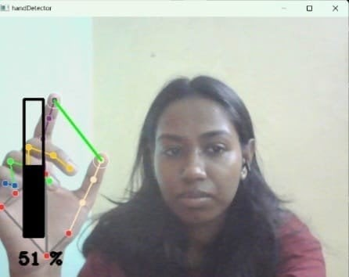
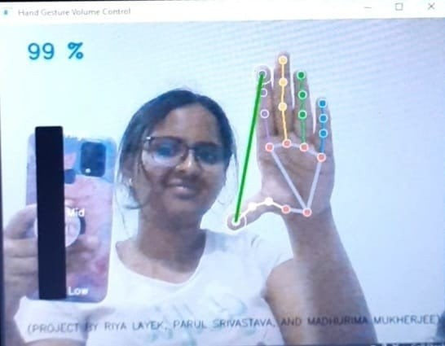
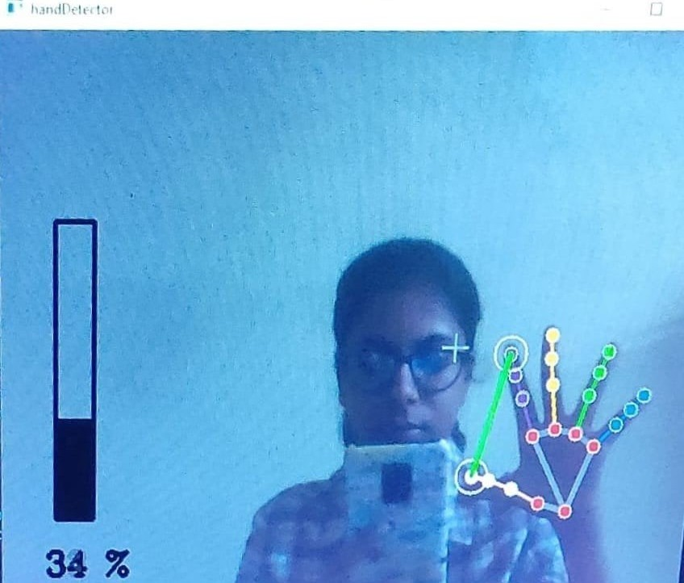
Project Overview
Our project focuses on enabling users to control system volume through hand gestures captured via webcam.Real-time Gesture
Recognition:We leverage advanced computer vision techniques to recognize and interpret hand gestures in real-time.
Advantages:This system offers advantages over traditional volume control methods by providing a more intuitive and hands-free interaction experience.

Slide 4

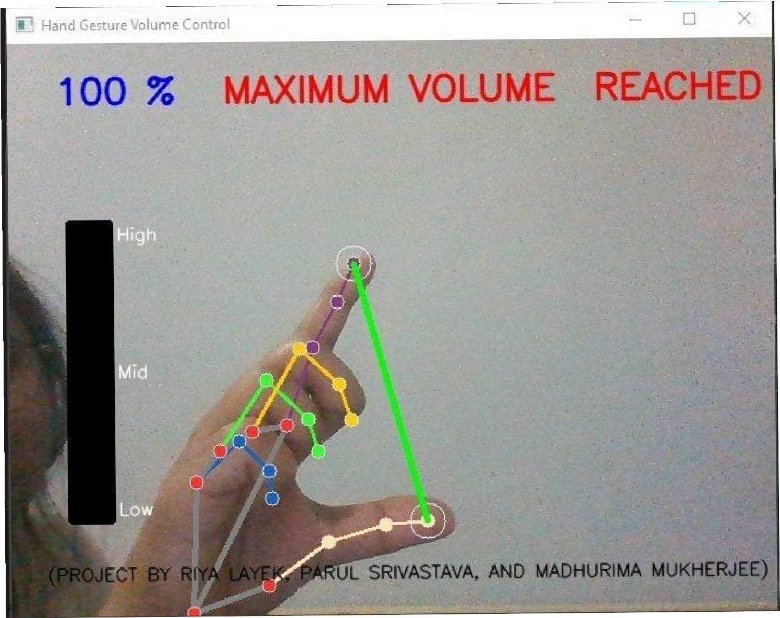
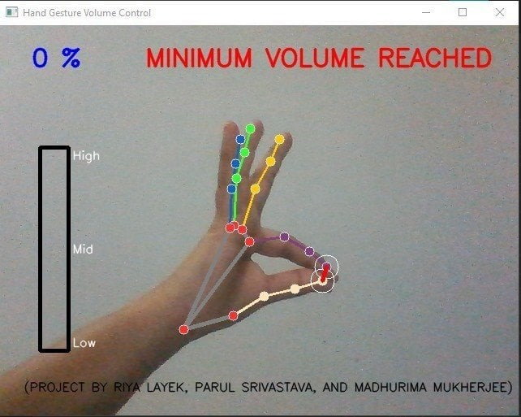
Key Features
-Real-time recognition and interpretation of hand gestures for volume adjustment.
Seamless integration with webcam input for gesture detection.
-Provision of visual feedback through dynamic volume bar visualization on the screen.
Display of informative messages to alert users when volume thresholds are reached.
Customizability and extensibility of the Python script for tailored integration into diverse applications.

Slide 5

System Requiremnts
System Requirements:
Python3.x OpenCV MediaPipe PyCaw Comtypes
Installation Instructions:
Install the required libraries using pip:
pip install opencv-python mediapipe pycaw comtypes

Slide 6


Usage Instructions
1. Install the requisite libraries using pip: pip install opencv-python mediapipe pycaw comtypes.
Execute the hand_gesture_volume_control.py script.
Position your hand within the webcam's ﬁeld of view.
4. Perform speciﬁc hand gestures to control volume adjustments:
Bring your thumb and index ﬁnger closer to decrease volume.
Move your thumb and index ﬁnger apart to increase volume.
Receive visual feedback through the dynamic volume bar displayed on the screen.
Stay informed via on-screen messages when volume thresholds are attained.

Slide 7

Utilized Libraries and APIs
The project harnesses a variety of libraries and APIs, including:
- OpenCV: Facilitates webcam input handling and image processing.
- MediaPipe: Empowers real-time hand landmark detection and tracking.
- PyCaw: Facilitates interaction with the Windows Audio Session API for volume control.
- Comtypes: Enables communication with the Windows operating system.

Slide 8

Webcam Conﬁguration and Initialization
The script initializes and conﬁgures webcam settings such as resolution and frame rate to optimize hand gesture detection performance.
Hand Landmark Detection and Tracking
Employing MediaPipe's hand landmark detection model, the system accurately identiﬁes and tracks crucial hand landmarks in real-time.
Volume Adjustment Algorithm
A sophisticated algorithm computes the distance between thumb and index ﬁnger landmarks to dynamically adjust volume levels. This distance is then mapped to a volume percentage for precise volume control.
Visual Feedback Mechanism
A dynamic volume bar on the screen provides users with visual feedback, enhancing user awareness and facilitating interaction.
Message Display Logic
Informative messages are displayed on-screen to promptly notify users when volume thresholds are reached, ensuring a seamless user experience.

Slide 9

Conclusion
In conclusion, our Gesture-based Volume Control System offers an innovative approach to user interaction.
By leveraging hand gestures, we enhance accessibility and provide a more engaging user experience.
We believe this technology has vast potential for various applications and future enhancements.

Slide 10

Thankyou
Presented by:
Riya Layek CSBS 04 Parul Srivastava CSBS 08
Madhurima Mukherjee CSBS 25

